Slide 1
Fully automated hydroponic system for small scale production
By:
UMESH HARIHARA SUDAN M
PIRYANKA K ROJIN RAJU
SRI SAKTICHARAN N

Slide 2
Introduction:
Climate change and population increase are some major threats to the community. Climate change has caused a rise of 1 degree in earths temperature. Continued changes in the frequency and intensity of precipitation, heat waves, and other extreme events are likely, all which will impact agricultural production. Furthermore, compounded climate factors can decrease plant productivity, resulting in price increases for many important agricultural crops. Global food production patterns would be fundamentally altered by climate change, causing food insecurity, Increase in demand for food because of small shifts in seasonality and water availability.

Slide 3
Proposed solution
Indoor hydroponic vertical farm is the most logical way to overcome the issues of lack of land, water and resources.
In a hydroponic farm the crops are grown in the absence of soil with only the nutrient filled water given to the roots.
In order to make vertical farming a more feasible alternative we can provide a fully automated and easily portable solution with the help of IOT.
This way people who are enthusiastic to try out vertical farming can easily exercise it, making vertical farming a more commercially viable solution.

Slide 4
Working
The customer is provided with a rack with multiple levels of arrays which contains all the provisions for constant irrigation, temperature and light control, nutrient level monitoring, etc.
The customer can choose any suitable crop and sow them in the arrays. The type of crop is updated to the system via an app.
The customer can fill the reservoir with a hydroponic solution as suggested by the app. Every parameter of the crop can be viewed by the customer via the app through various sensors.
The customer will get constant updates on when to refill the reservoir and harvesting period. When the crops are ready to harvest they can be sold and the process can be continued any time of the year
1
2
3
4

Slide 5
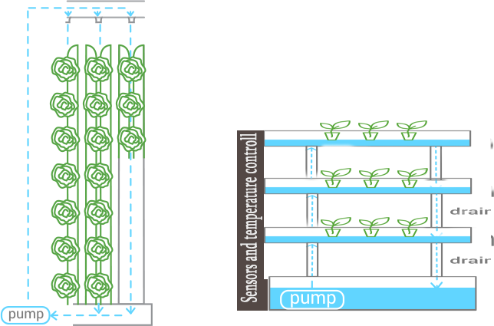
Diagram

Slide 6
Future Scope
The target beneficiaries for this project is anyone aspiring to make and sell off-season crops in the cityscape.
Our product can be used by hotels to obtain fresh crops.
Super markets and malls can also use this technology to provide fresh food much cheaper as transportation cost will not be an issue. They can grow plants in their premises.
This project aims to resolve the major problem that will faced by the community in future .(Taking the Increasing population in mind)
Round the year we can produce crops irrespective of the climatic conditions.

